Slide 1
Gold King Mine Incident San Juan County, Colorado A CASE STUDY IN CRITICAL THINKING
CE 4200
Professional Engineering Practice Issues
Spring 2022 Semester
William D. Lawson, PE, PhD

Slide 2
SUMMARY
CRITICAL THINKING CASE STUDY: Gold King Mine Incident
CE 4200: Professional Engineering Practice Issues
Spring 2022 Semester
William D. Lawson, PE, PhD

Slide 3
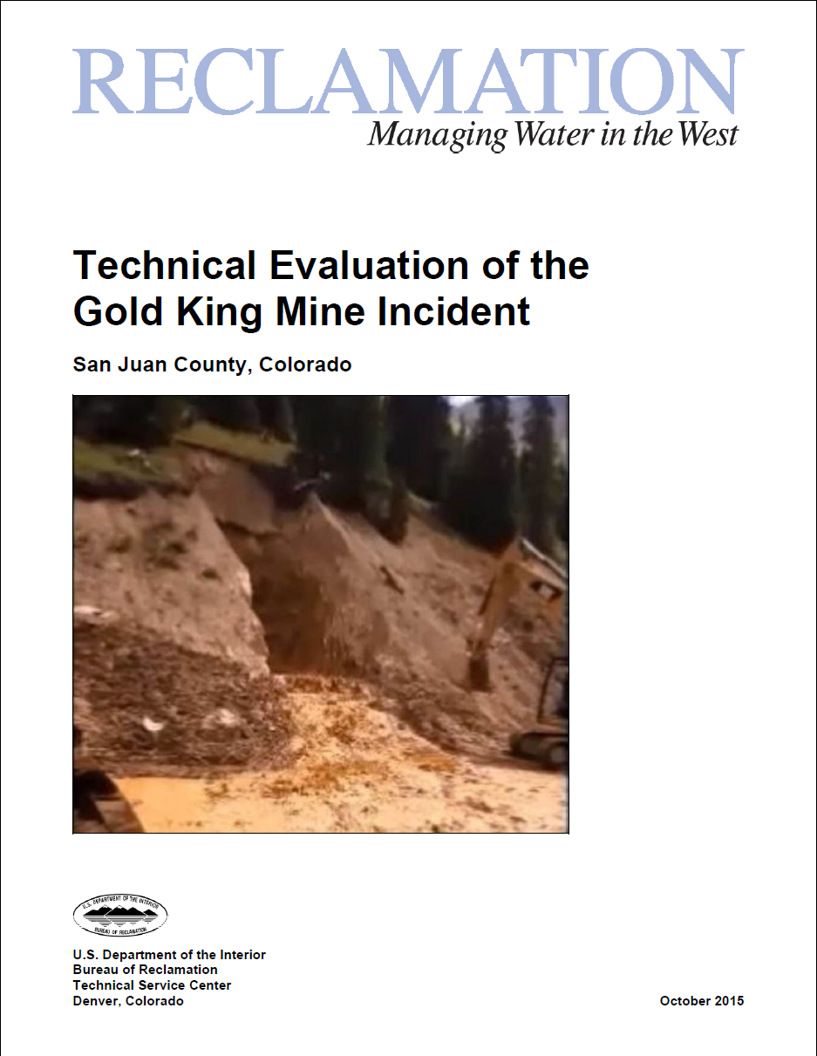
Source Documents CASE STUDY: Gold King Mine Incident
Video news reports
Published news articles
Personal observation
Technical Evaluation of the Gold King Mine Incident

Slide 4
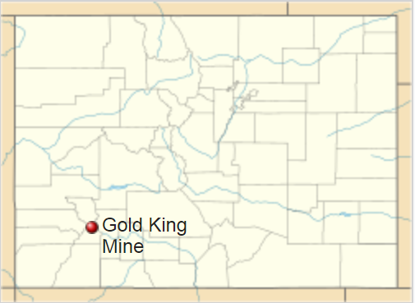
Overview Incident Summary: Gold King Mine Spill
The 2015 Gold King Mine wastewater spill was an environmental disaster that began at the Gold King Mine near Silverton, Colorado.
Image Source: Wikipedia

Slide 5
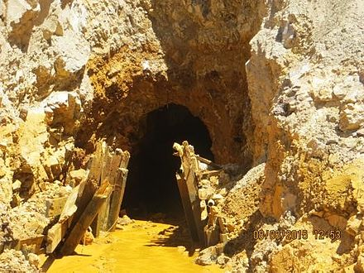
EPA Destroys Mine Plug Incident Summary: Gold King Mine Spill
Environmental Protection Agency personnel, along with workers for Environmental Restoration LLC (a Missouri company under EPA contract to mitigate pollutants from the closed mine), caused the release of toxic waste water into the Animas River watershed.
They caused the accident while attempting to drain ponded water near the entrance of the mine on August 5.
Contractors accidentally destroyed the plug holding water trapped inside the mine.
Image Source: Wikipedia

Slide 6
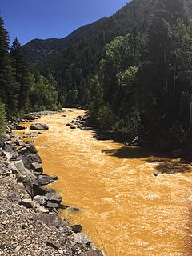
3 Million Gallons Toxic Waste Incident Summary: Gold King Mine Spill
This caused an overflow of the pond, spilling three million gallons of mine waste water and tailings, including heavy metals such as cadmium and lead, and other toxic elements, such as arsenic, beryllium, zinc, iron and copper into Cement Creek, a tributary of the Animas River in Colorado.
Image Source: Wikipedia

Slide 7
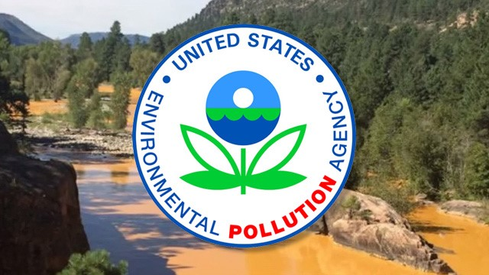
The EPA’s Responsibility Incident Summary: Gold King Mine Spill
The EPA was criticized for not warning Colorado and New Mexico about the operation until the day after the waste water spilled, despite the fact the EPA employee "in charge of Gold King Mine knew of blowout risk."
The EPA has taken responsibility for the incident, but refused to pay for any damages claims filed after the accident on grounds of sovereign immunity…
Image Source: Capital Research Center

Slide 8
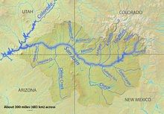
A Disaster Zone Incident Summary: Gold King Mine Spill
Governor of Colorado John Hickenlooper declared the affected area a disaster zone. The spill affects waterways of municipalities in the states of Colorado, New Mexico, and Utah, as well as the Navajo Nation.
Image Source: Wikipedia

Slide 9
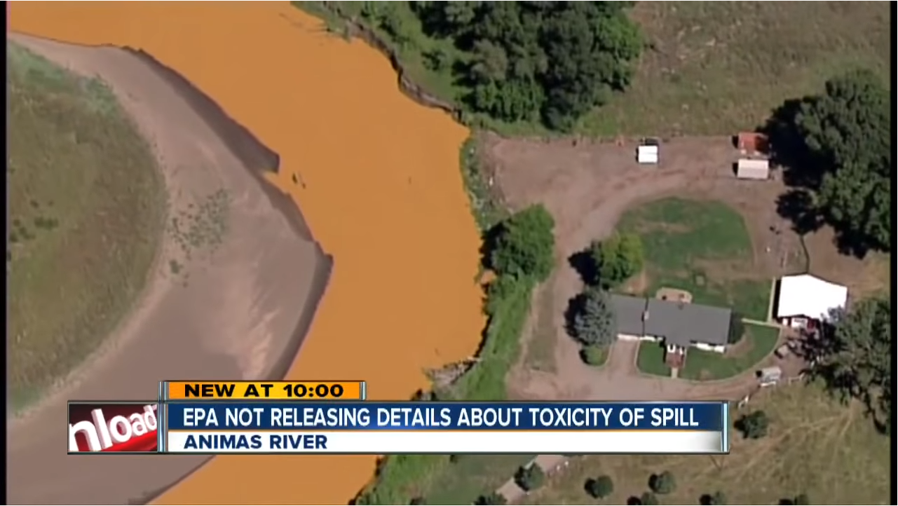
Channel 7 News Report Denver, CO (8 August 2015)

Slide 10
BACKGROUND
CRITICAL THINKING CASE STUDY: Gold King Mine Incident
CE 4200: Professional Engineering Practice Issues
Spring 2022 Semester
William D. Lawson, PE, PhD

Slide 11
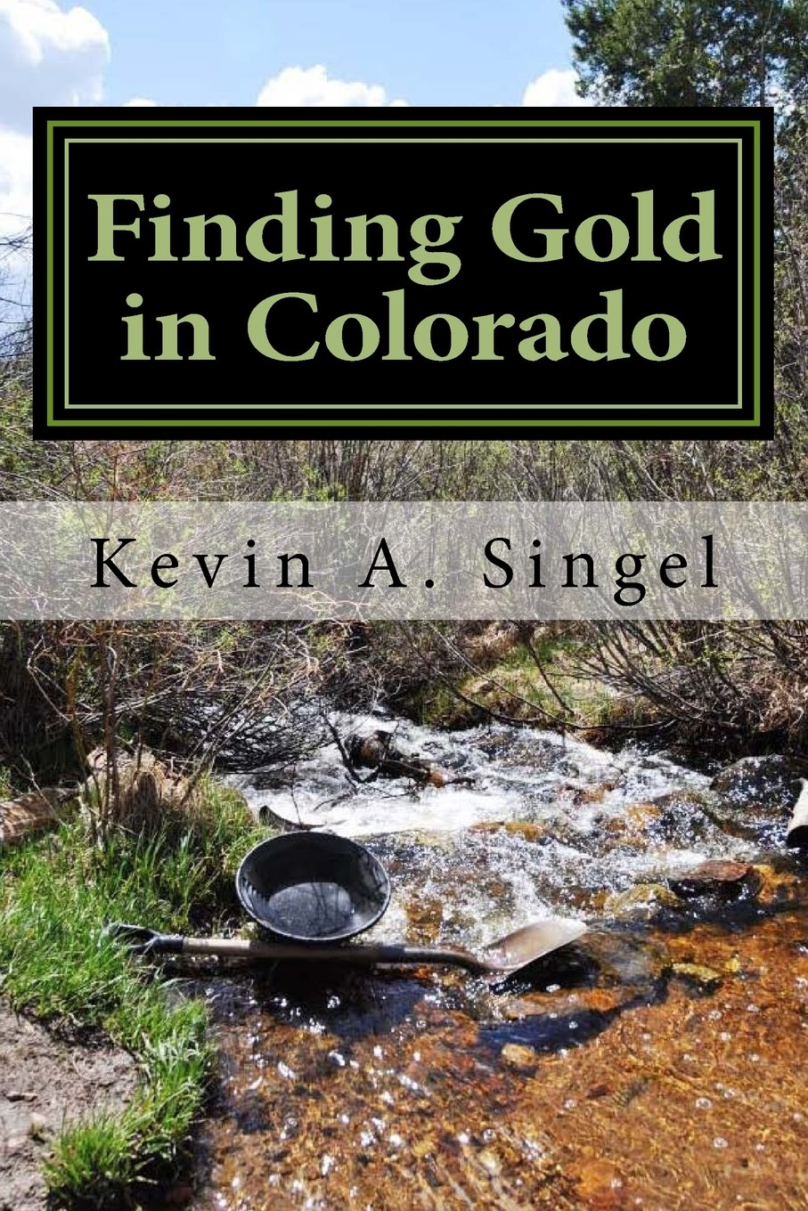
Prospecting for Gold… it’s a “thing” in Colorado
“There’s gold in them thar hills…”
Those rich words still hold true long after the vanished cries of “Pikes Peak or Bust!” brought hordes of treasure seekers to the Colorado Rockies in 1859.
Gold is still found in those hills, you just need to get out there and find it.
Some of the best places in Colorado to learn about the mining heritage, get up close to gold in underground tunnels, and try your hand at panning for gold to strike it rich [include]…

Slide 12

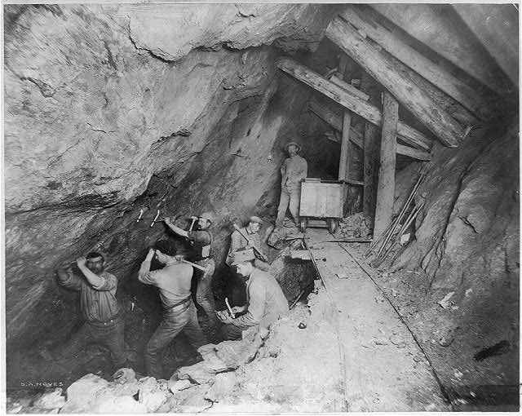
Gold Discovery in Colorado Colorado Geological Survey
Gold discoveries in Colorado began around Denver in the 1850s
Placer gold was traced to its source in the mountains west of Denver, then followed the Colorado Mineral Belt in a southwest direction across the state to its terminus in the San Juan Mountains.
Since 1859 Colorado’s mines have produced about 45 million ounces of gold.
Miners work inside the Gold King Mine, near Silverton, Colorado, in 1899.
Image Source: Colorado Public Radio News

Slide 13
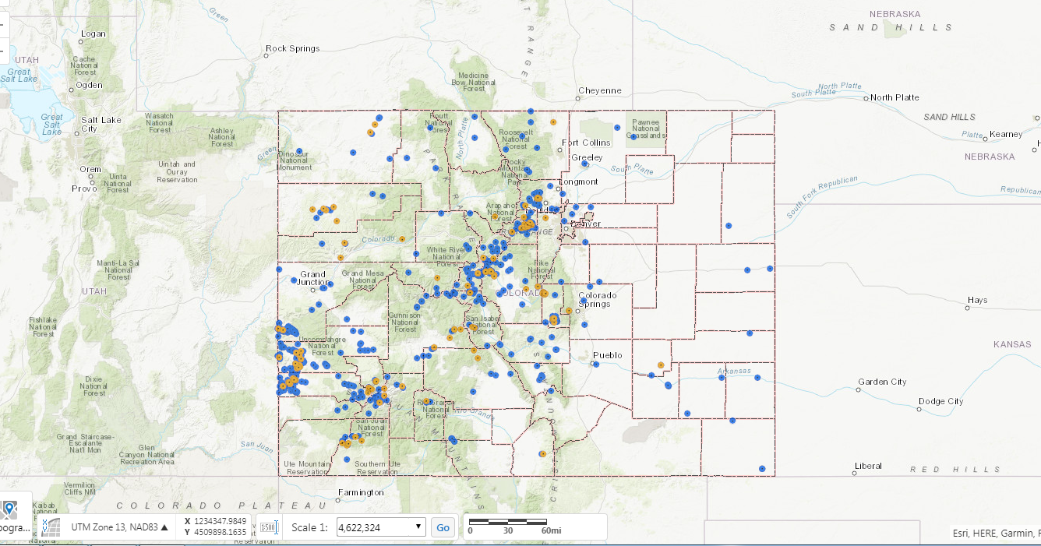
Thousands of Hardrock Mines in Colorado Inactive & Active Hardrock Permits
The Gold King Mine is one of an estimated 23,000 abandoned mines dotting the state of Colorado.
Image Source: Colorado Division of Reclamation Mining & Safety

Slide 14
Glossary of Mining Terms US Securities and Exchange Commission
Adit - An opening driven horizontally into the side of a mountain or hill for providing access to a mineral deposit.
Back - The ceiling or roof of an underground opening.
Cyanidation - A method of extracting exposed gold or silver grains from crushed or ground ore by dissolving it in a weak cyanide solution. May be carried out in tanks inside a mill or in heaps of ore out of doors.
Drift - A horizontal underground passage that follows along the length of a vein or rock formation as opposed to a crosscut which crosses the rock formation.
Lagging - Planks or small timbers placed between steel ribs along the roof of a stope or drift to prevent rocks from falling, rather than to support the main weight of the overlying rocks.
Ore - A mixture of ore minerals and gangue (the worthless minerals in an ore deposit) from which at least one of the metals can be extracted at a profit.
Pan - To wash gravel, sand or crushed rock samples in order to isolate gold or other valuable metals by their higher density.
Placer - A deposit of sand and gravel containing valuable metals such as gold, tin or diamonds.
Shaft - A vertical or inclined excavation in rock for the purpose of providing access to an orebody. Usually equipped with a hoist at the top, which lowers and raises a conveyance for handling workers and materials.
Talus - A heap of broken, coarse rock found at the base of a cliff or mountain.

Slide 15
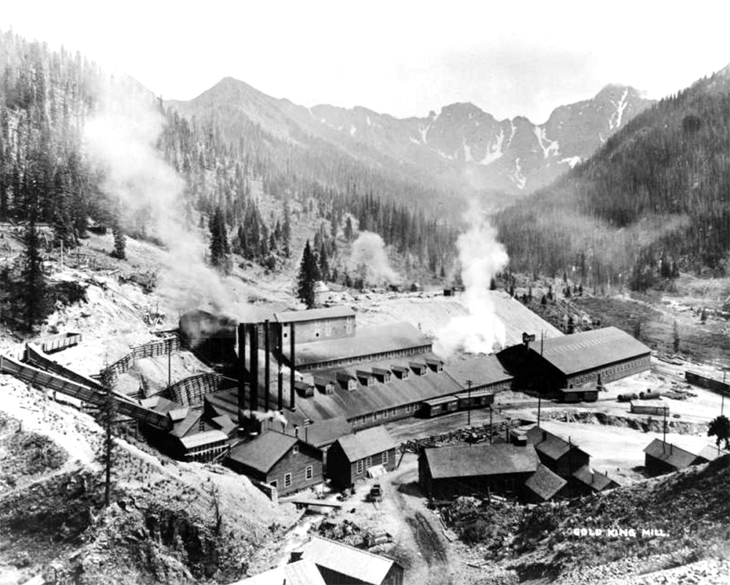
The Gold King Mine History: “EPA Watershed Fact Sheet”
The Gold King Mine was discovered by Olaf Nelson in 1887.
The mine operated from about 1894 to 1922.
The Gold King Mine shipped 711,144 tons of gold and silver ore while in operation.
The mine has been inactive since about 1924. It is currently owned by San Juan Corporation.
View of the Gold King Mill, in San Juan County Colorado; shows gold mine processing facilities, ore cars, cribbing, smokestacks, tailings, and mountain peaks. Taken between 1880 and 1920. (Denver Public Library/Western History Collection/X-61017)

Slide 16

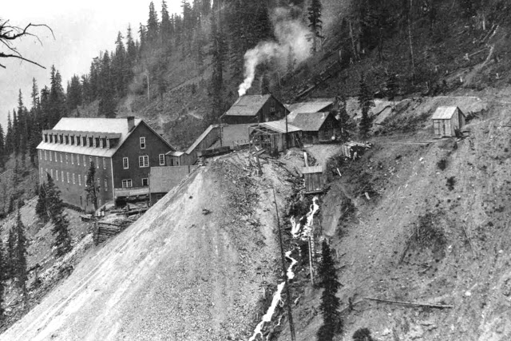
A Gold King Mine Timeline A tangled history of profit, tragedy and unfulfilled dreams.
Photo from 1906 of boarding house and other structures at the mouth of Gold King #7 Level clearly shows a 200 to 300 gallon per minute water discharge from the portal.
Source: High Country News: Jonathan Thompson, May 2, 2016

Slide 17
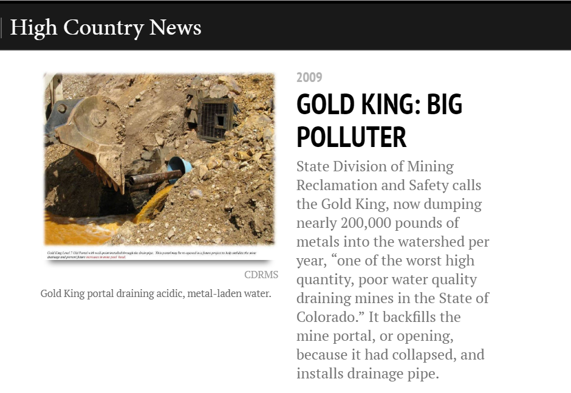

Slide 18
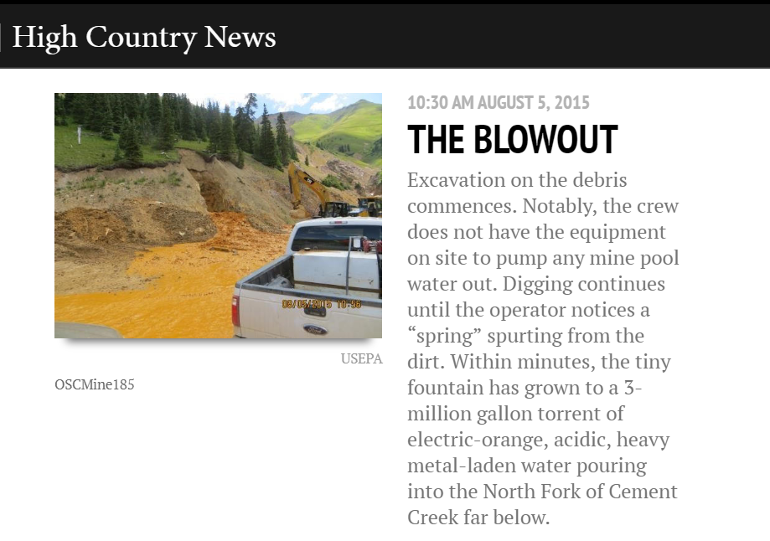

Slide 19
A FUNNY THING HAPPENED ON VACATION THAT SUMMER…
CRITICAL THINKING CASE STUDY: Gold King Mine Incident
CE 4200: Professional Engineering Practice Issues
Spring 2022 Semester
William D. Lawson, PE, PhD

Slide 20
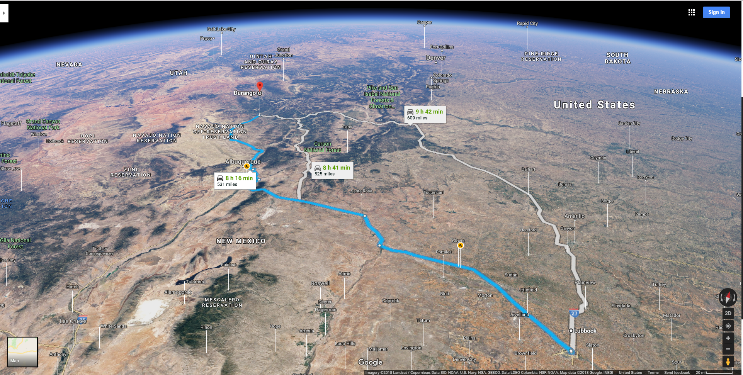
LUBBOCK TX TO DURANGO CO [531 MI / 8 HR 16 MIN]
DURANGO, CO
ALBUQUERQUE, NM
FORT SUMNER, NM
LUBBOCK, TX

Slide 21



Slide 22
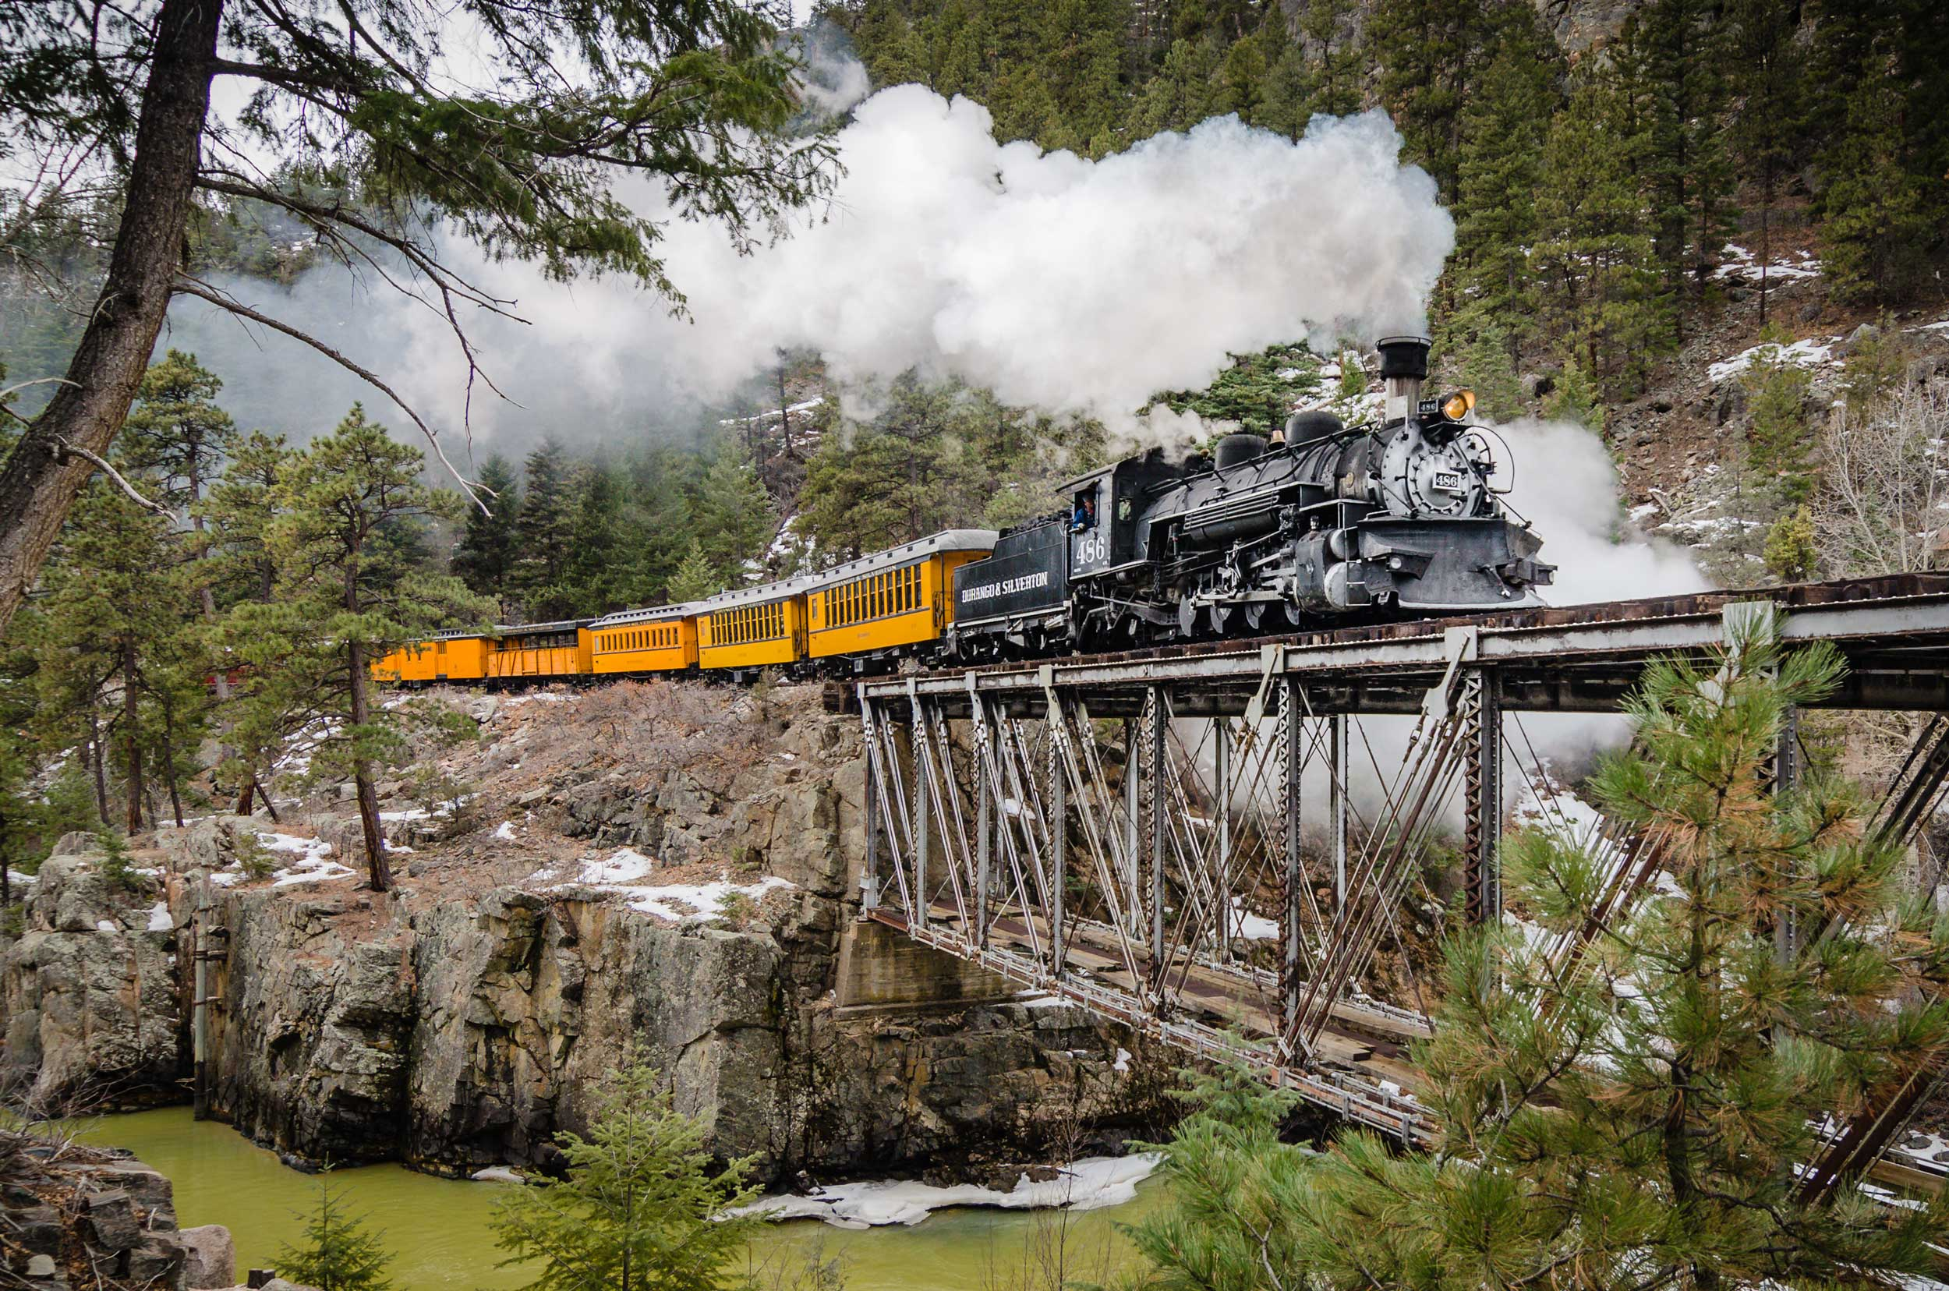
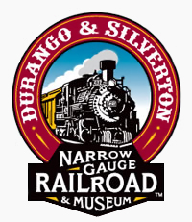

Slide 23
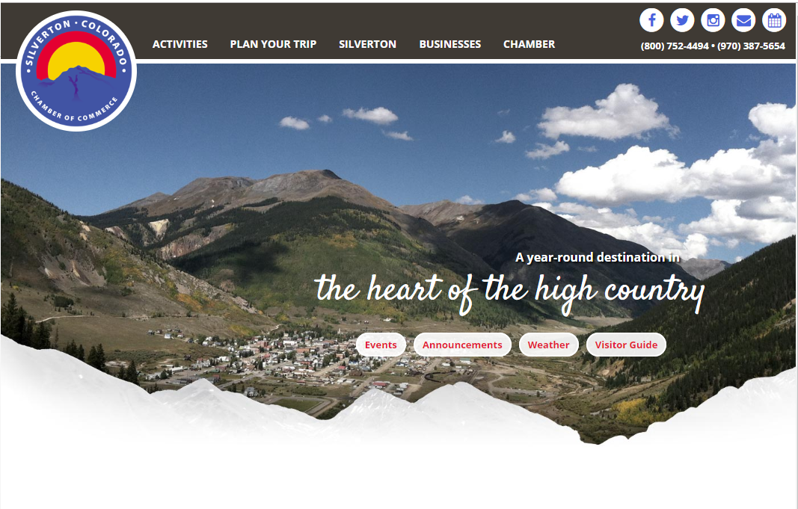
SILVERTON, COLORADO

Slide 24
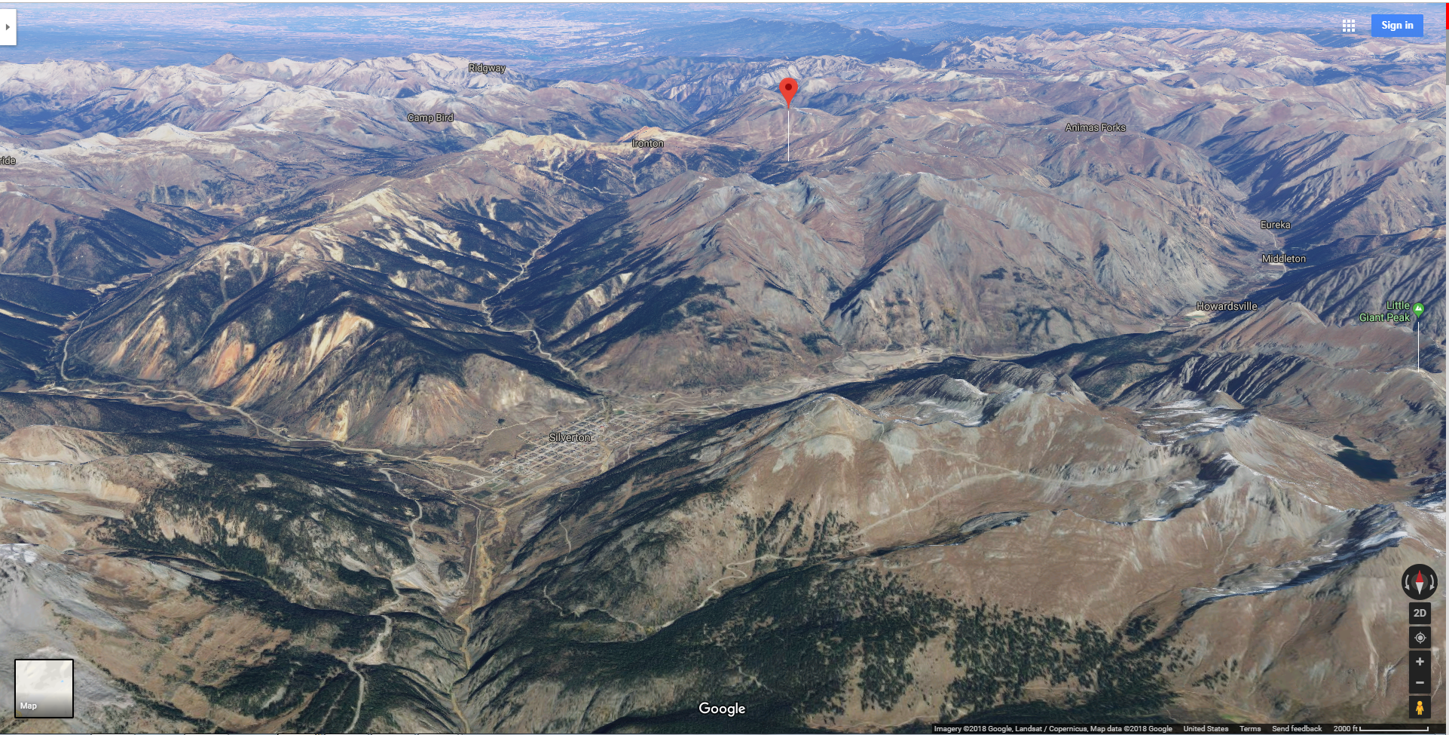
GOLD KING
MINE
OLD 100
GOLD MINE
SILVERTON
COLORADO
ANIMAS
RIVER

Slide 25
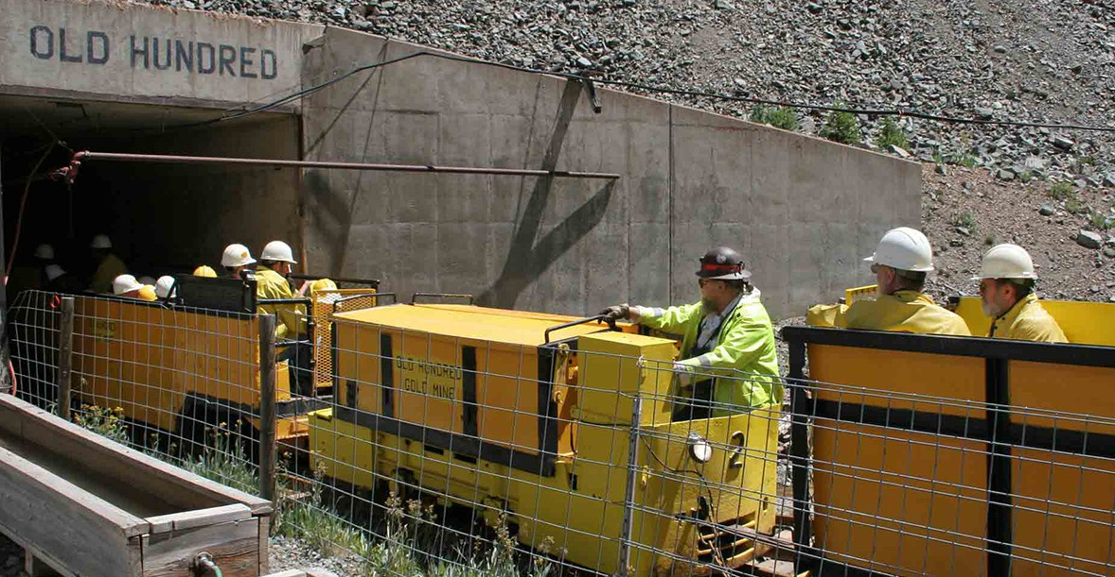
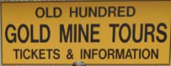

Slide 26
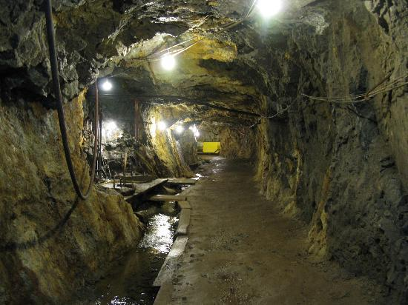

Slide 27
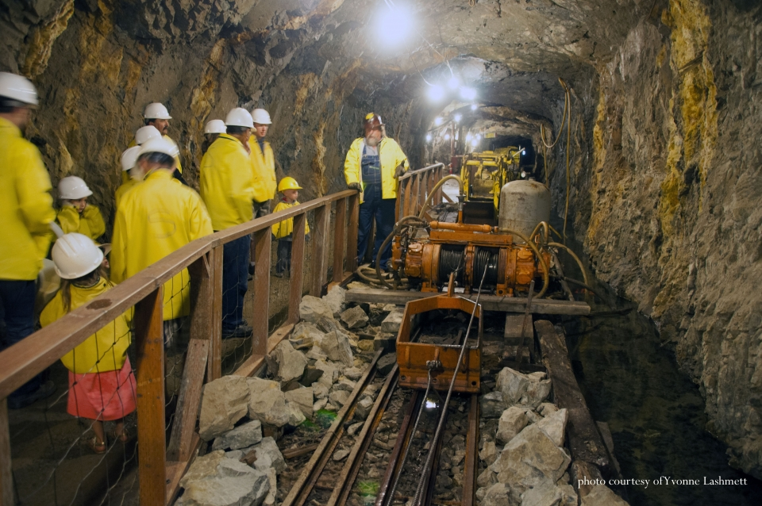

Slide 28
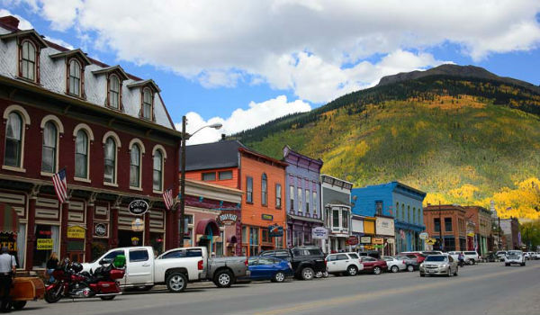


Slide 29
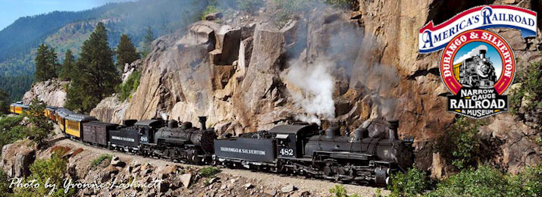

Slide 30
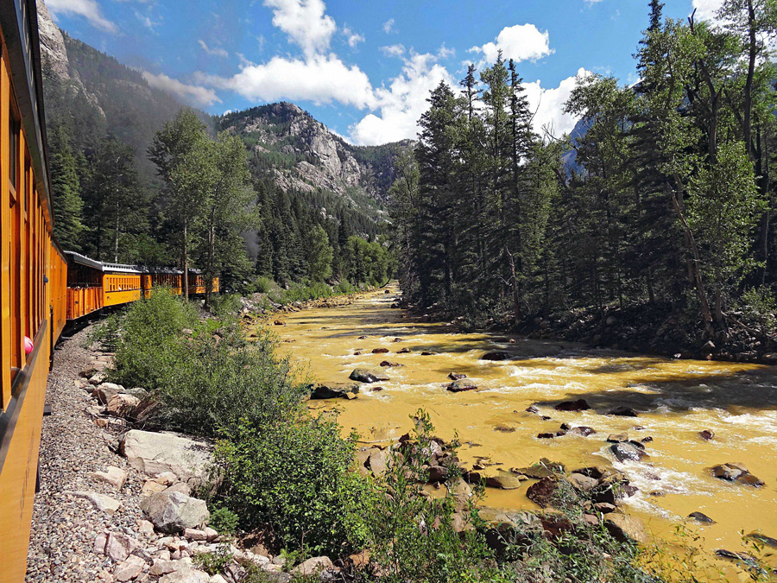

Slide 31
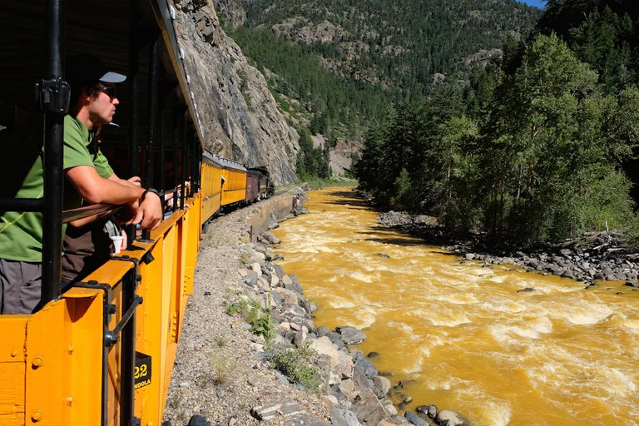
Three million gallons of mine waste water and tailings, including heavy metals such as cadmium and lead, and other toxic elements, such as arsenic, beryllium, zinc, iron and copper

Slide 32
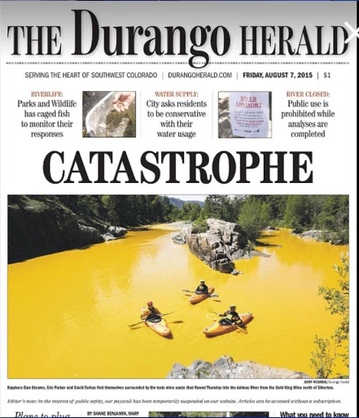

Slide 33
WHAT HAPPENED AT GOLD KING MINE
CRITICAL THINKING CASE STUDY: Gold King Mine Incident
CE 4200: Professional Engineering Practice Issues
Spring 2022 Semester
William D. Lawson, PE, PhD

Slide 34
Executive Summary Technical Evaluation of the Gold King Mine Incident
The uncontrolled release at Gold King Mine was due to a series of events spanning several decades.
Groundwater conditions in the upper reaches of Cement Creek have been significantly altered by the establishment of extensive underground mine workings, the extension of the American Tunnel to the Sunnyside Mine, and the subsequent plugging of the American Tunnel.
The final events leading to the blowout and uncontrolled release of water occurred due to a combination of
an inadequately designed closure of the mine portal in 2009, combined with
a misinterpretation of the groundwater conditions when reopening the mine portal in 2014 and 2015.

Slide 35
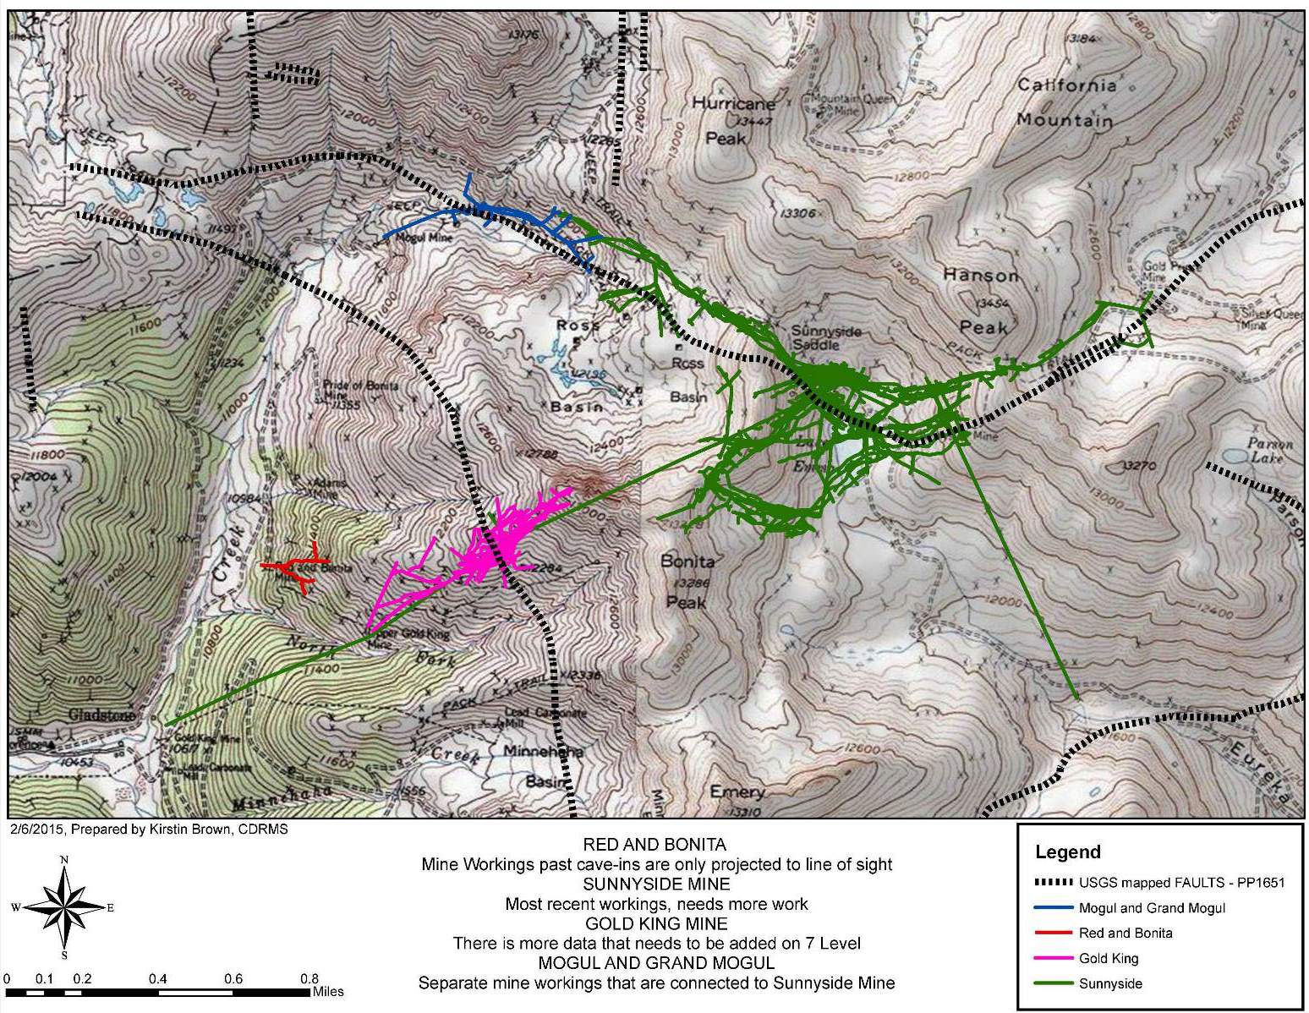
Figure 6.—Map showing topography and the location of the Sunnyside, Gold King, and Red and Bonita Mines workings in the Eureka mining district (graphic prepared by Kirstin Brown of the Colorado Division of Reclamation, Mining, and Safety on February 6, 2015).
GOLD KING MINE

Slide 36
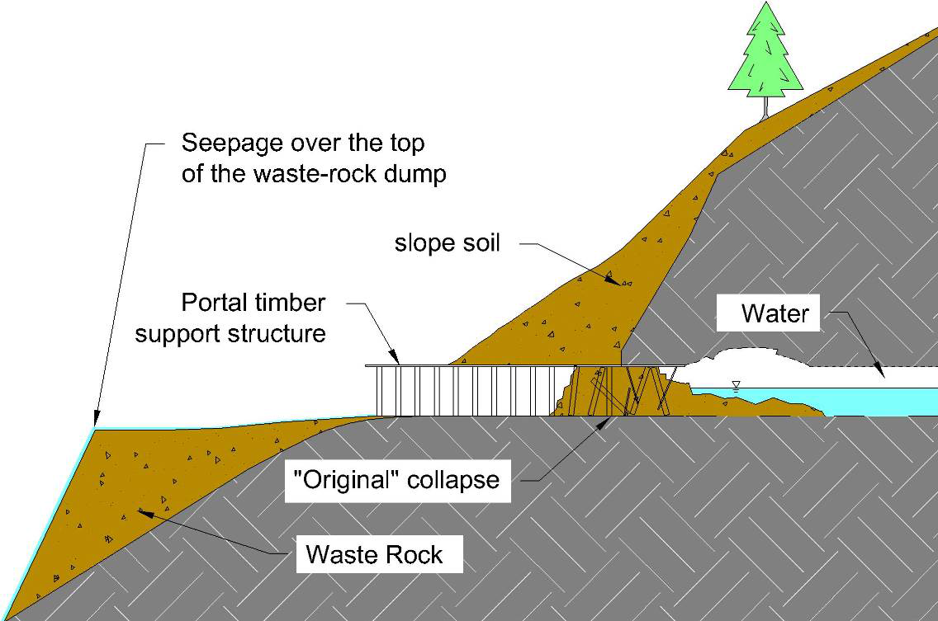
“THE SITUATION - 2007”
Figure 16.—Cross-section showing the condition of the Gold King Mine Level 7 New Adit in 2007 (not to scale). This shows the water level assumed by DRMS, but it may have been full of water at this time, as was later discovered.

Slide 37
Figure 14.—Photograph showing adit seepage infiltrating into the Gold King Mine Level 7 waste-rock dump in 2007 (from DRMS project files).

Slide 38
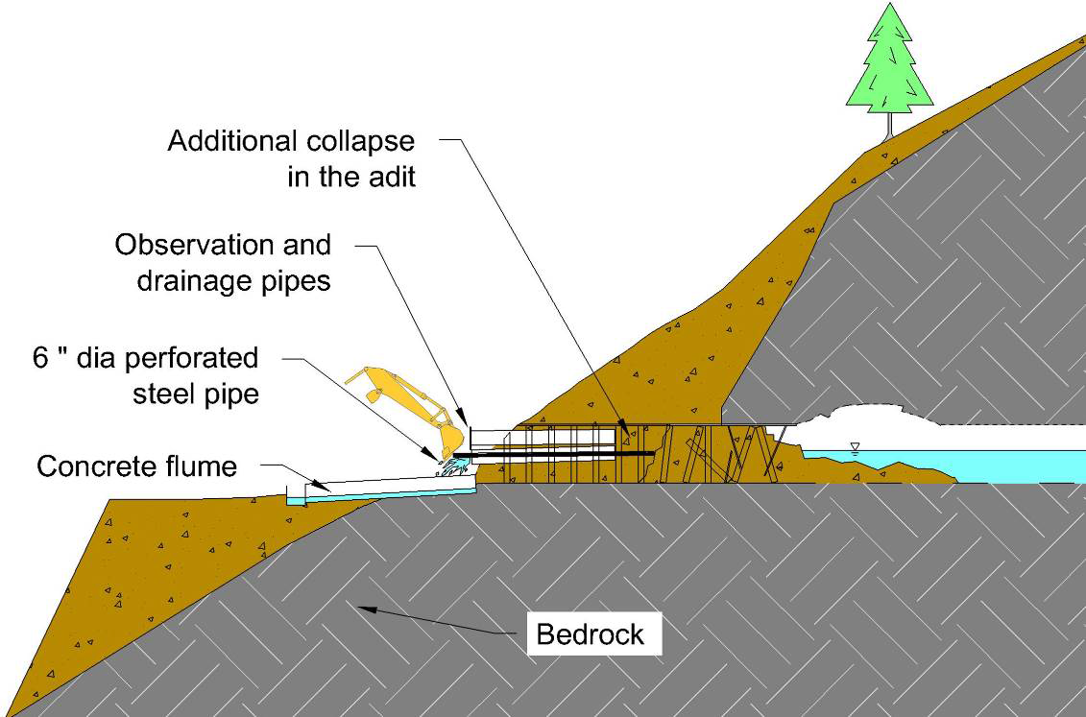
“THE FIX - 2009”
Figure 21.—Cross-section showing the installation of pipes by DRMS at the Gold King Mine Level 7 New Adit in 2009 (water level as assumed by DRMS) (not to scale).

Slide 39
EPA Activities in 2014
In 2014, EPA was requested by DRMS to reopen and stabilize the Gold King Mine Level 7 New Adit
The drainage system at the mine portal had reportedly not been maintained or monitored since its installation in 2009 (figures 22 through 24)
During the week of August 25, 2014, the flow was measured as 112 gpm. On September 11, 2014, prior to site work, the flow had declined to less than 12.6 gpm
The reason for reduced flow was unknown but speculated as being “related to seasonal inflows to the mine”

Slide 40
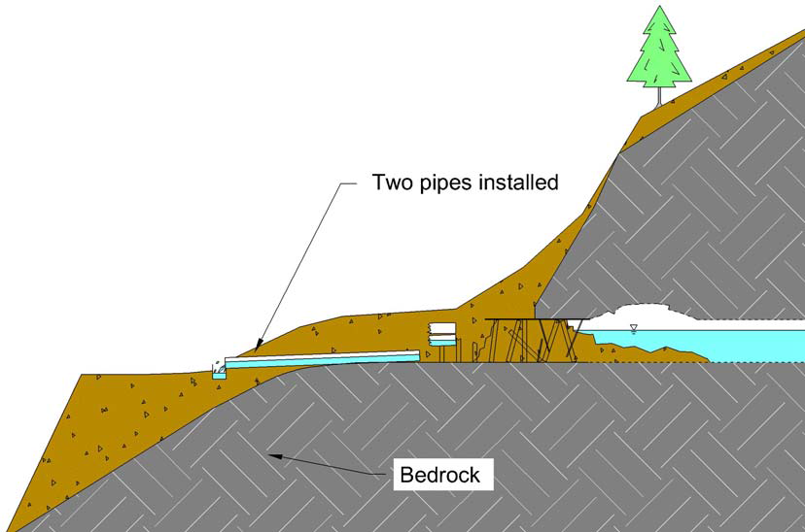
“THE FIX - 2014”
Figure 30.—Cross-section showing the condition of the Gold King Mine Level 7 New Adit in 2014 (water level as assumed by EPA and DRMS), after the installation of the two drain pipes and backfill cover (not to scale).

Slide 41
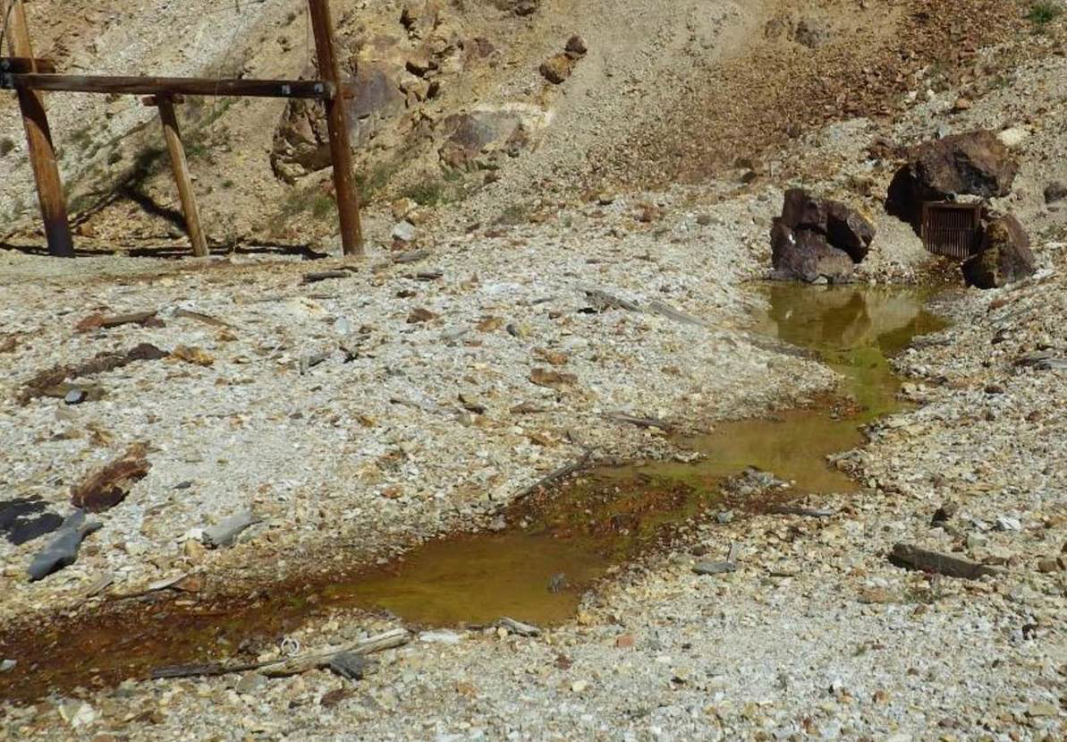
Figure 31.—Gold King Mine Level 7 OLD Adit (upper right) showing a small amount of seepage flow on September 11, 2014. At the portal, the floor of the old adit is approximately 2 feet higher than the floor of the old adit portal (photograph from EPA project files).

Slide 42
EPA Activities in 2015
Personnel from EPA contractor Weston Solutions, Inc. visited the site on June 24, 2015, and measured the Gold King Mine discharge as 31 gpm. There was still snow on the ground and they had to walk in.
On July 14, 2015, EPA returned to the site and found more erosion and landsliding of the slope above the adit and that the rock and soil debris had covered the ends of the pipes they previously installed in 2014.
Much of the adit seepage flow was bypassing the concrete-trough diversion channel and instead was flowing onto the waste-rock dump
On July 15, 2015, they took another measurement, which indicated the drainage flow was 69 gpm

Slide 43
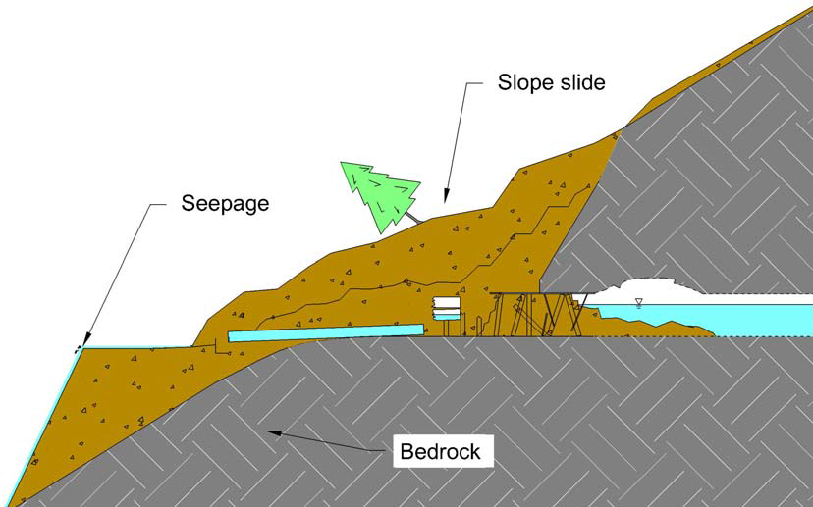
Figure 34.—Cross-section showing the condition of the Gold King Mine Old Adit on July 14, 2015 (water level as assumed by EPA and DRMS), when EPA returned to the site to begin work. More rock and soil and a tree had slid down onto the drains, and seepage was again saturating part of the waste-rock dump (not to scale).

Slide 44
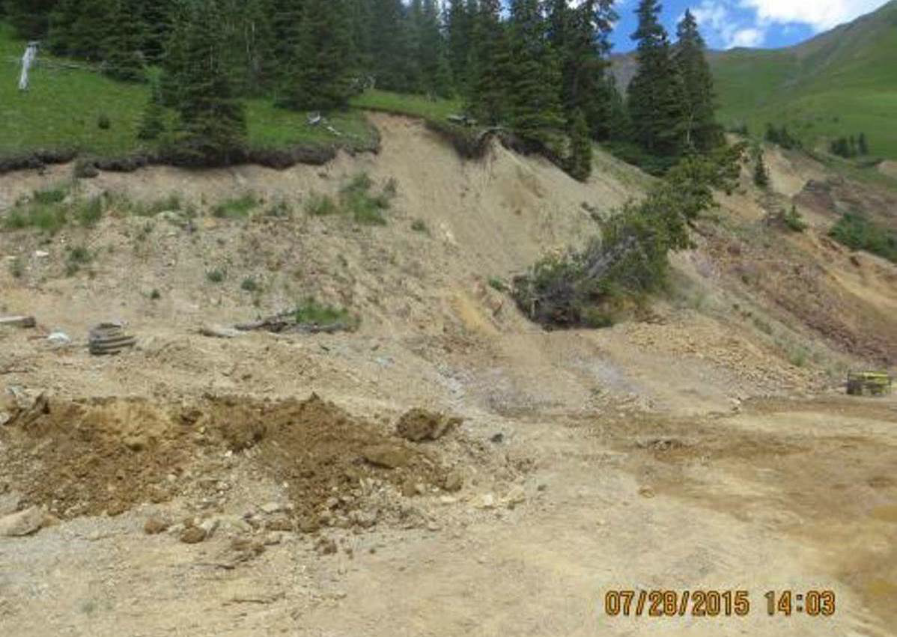
Figure 35.—Photograph showing the condition of the Gold King Mine Level 7 New Adit portal area on July 28, 2015. Note the soil and a tree that has slid downslope onto the portal area; at this time the seepage had been returned to the concrete trough, and the dump was drying out (photograph from EPA project files).

Slide 45
EPA Activities in 2015, continued
On August 4, 2015, a representative from DRMS was onsite and viewed conditions at the adit. EPA began excavation to examine conditions close to the mine opening similar to what had been done in 2014
Once again, they observed conditions similar to what was seen the previous year—water was seeping out at an elevation about 5 or 6 feet above the floor of the adit
At this juncture, EPA, DRMS, and the contractors discussed a plan to open the adit.

Slide 46
Figure 37.—Photograph showing additional excavation at the Gold King Mine Level 7 New Adit at 10:28 a.m. August 4, 2015 (photograph from EPA project files).

Slide 47
EPA Activities in 2015, continued
EPA, DRMS, and the contractors reportedly believed they could use a similar plan to what was done at the Red and Bonita Mine in 2011
This was because the seepage they were observing at that time in the excavation of the fill covering the mine portal was at an elevation corresponding to that of a partially full mine adit.

Slide 48
Figure 38.—Photograph showing seepage flow from the excavation at the Gold King Mine new portal at 11:48 a.m. on August 4, 2015. The flow is emerging approximately 5 to 6 feet above the floor of the adit (photograph from EPA project files).

Slide 49
THE PLAN TO OPEN THE ADIT
CRITICAL THINKING CASE STUDY: Gold King Mine Incident
CE 4200: Professional Engineering Practice Issues
Spring 2022 Semester
William D. Lawson, PE, PhD

Slide 50
The Plan to Open the Adit
Figure 39 shows a sketch of the plan to open the Gold King Mine Level 7 New Adit portal. To provide a margin of safety, the plan assumes the water was more than 5 feet deep on the upstream side of the blockage, but still below the adit roof
The cross-section view from figure 39 was used as the basis for illustrating the steps that EPA was going to take to open the adit
A key aspect of their plan was to only excavate fill lying above the assumed top of the water inside the adit. This method would leave in place the fill holding back the water
The next step would push a steel pipe called a “stinger” through the top of the fill to gain access to the mine pool

Slide 51
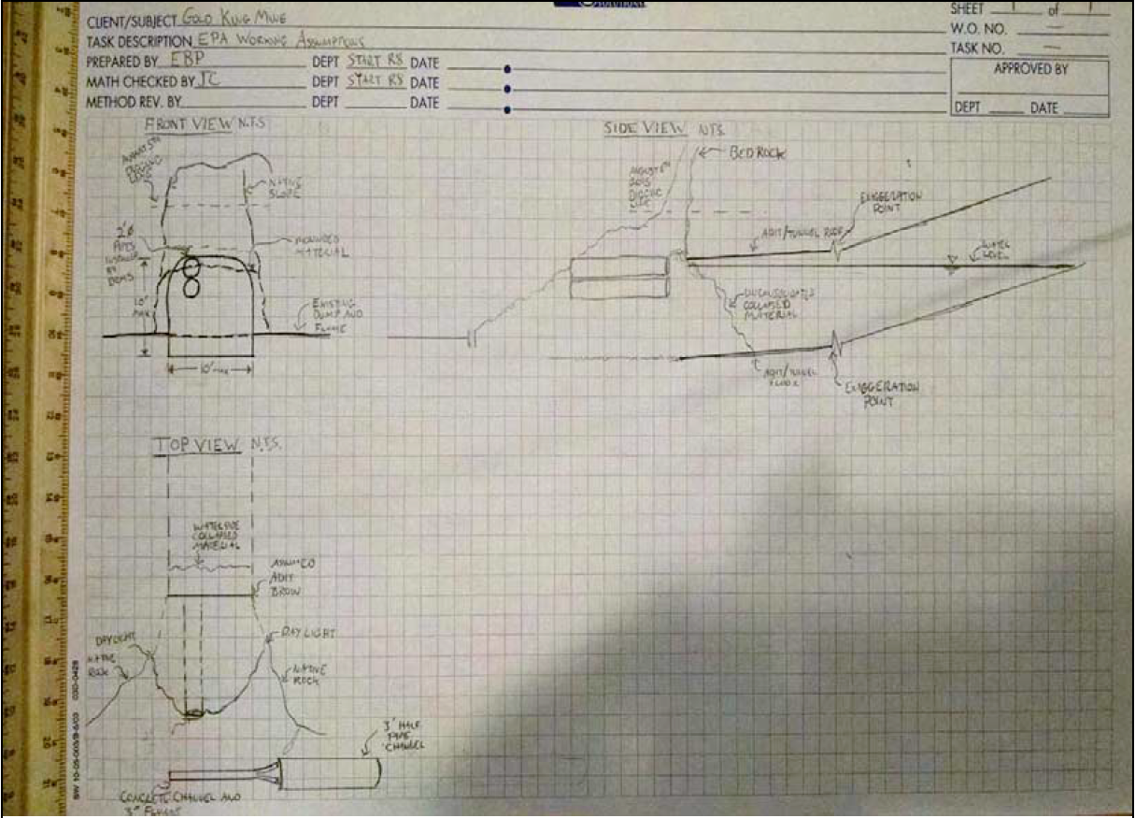
Figure 39.—Photograph showing the sketch used by EPA to illustrate the conditions at the Gold King Mine Level 7 New Adit portal (photograph from EPA project files).

Slide 52
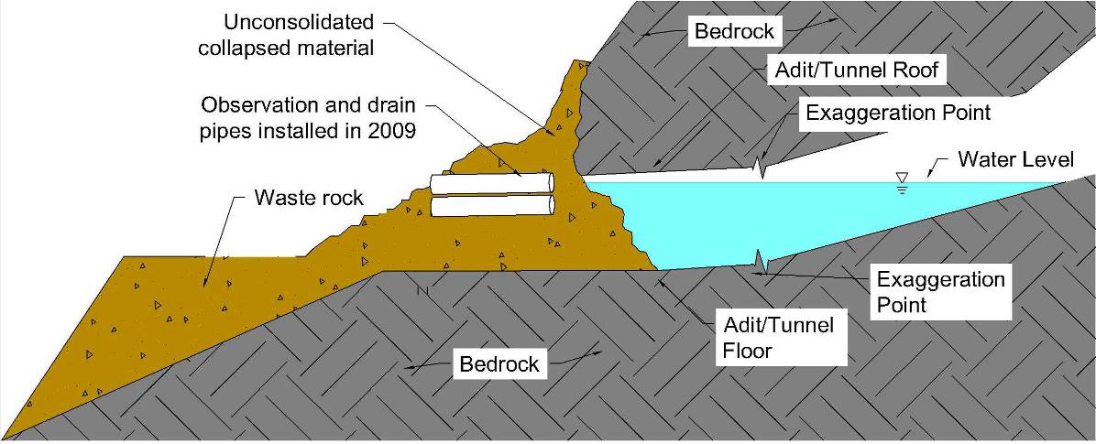
Figure 40.—Cross-section illustration showing the condition of the adit that was assumed by the EPA OSC and the abandoned mine experts from DRMS for use in planning to open the adit (not to scale). The “exaggeration point” means the right side of the drawing has an exaggerated vertical scale in order to show the 1% uphill slope of the adit. If drawn without exaggeration, the uphill slope of the adit would not be obvious on the drawing.

Slide 53
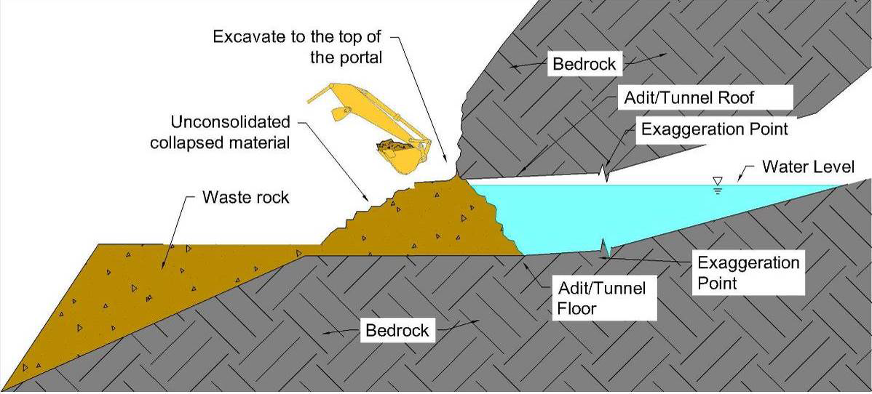
Figure 41.—Cross-section illustration showing step 1, the initial excavation to remove the drain pipes and backfill and then carefully excavate the collapsed material to expose the bedrock in the slope above the adit (not to scale).

Slide 54
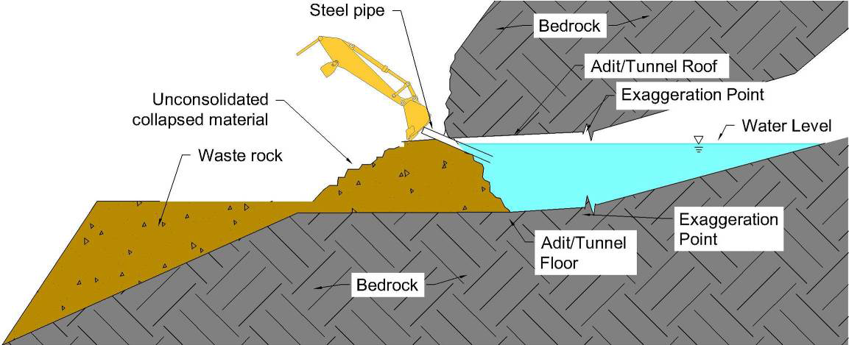
Figure 43.—Cross-section illustration showing step 3 of the plan (not to scale). With the bedrock above the crown of the adit exposed as a guide, a steel pipe called a “stinger” is positioned and pushed into the fill using the bucket of the hydraulic excavator. With the steel pipe fully inserted, contact is made with the water impounded inside the mine.

Slide 55
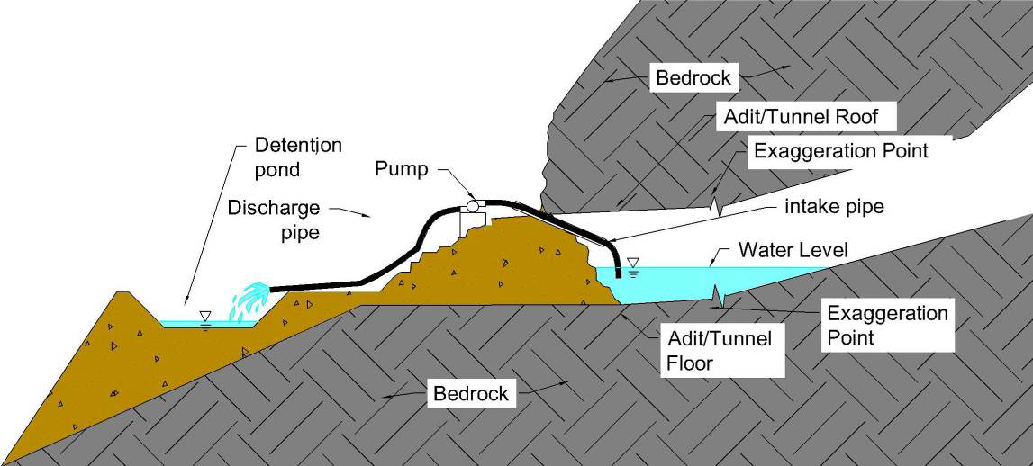
Figure 44.—Cross-section illustration showing step 4 of the plan (not to scale). An intake hose from a pump is inserted into the steel pipe. The pump discharge is taken to a small pond constructed on the waste rock dump. Water from the adit is pumped down. Not shown on this illustration is that the water in the small pond would be continuously removed by another pump and sent to treatment elsewhere on the site.

Slide 56
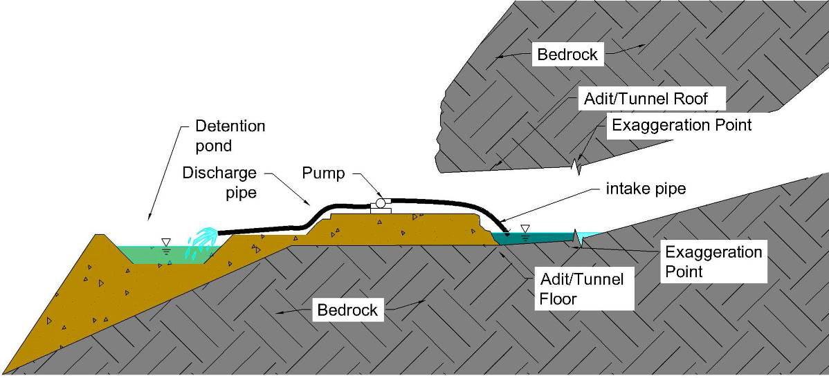
Figure 45.—Cross-section illustration showing step 5 of the plan (not to scale). As the water inside the mine is drawn down by pumping, additional fill from the blockage is excavated and the pump is repositioned to a lower level on the remaining fill. This step is repeated until all the impounded water and the remaining fill is removed; this will establish access to an open adit with the flow freely draining out.

Slide 57
IMPLEMENTATION OF THE PLAN
CRITICAL THINKING CASE STUDY: Gold King Mine Incident
CE 4200: Professional Engineering Practice Issues
Spring 2022 Semester
William D. Lawson, PE, PhD

Slide 58
Implementation of the Plan by EPA on August 5, 2015
On the morning of August 5, 2015, a second DRMS abandoned mine specialist arrived at the site
The two DRMS specialists joined the EPA OSC to view conditions at the Gold King Mine Level 7 New Adit
The upper seepage appeared stable and was a few feet below the top of the timbers in the excavation

Slide 59
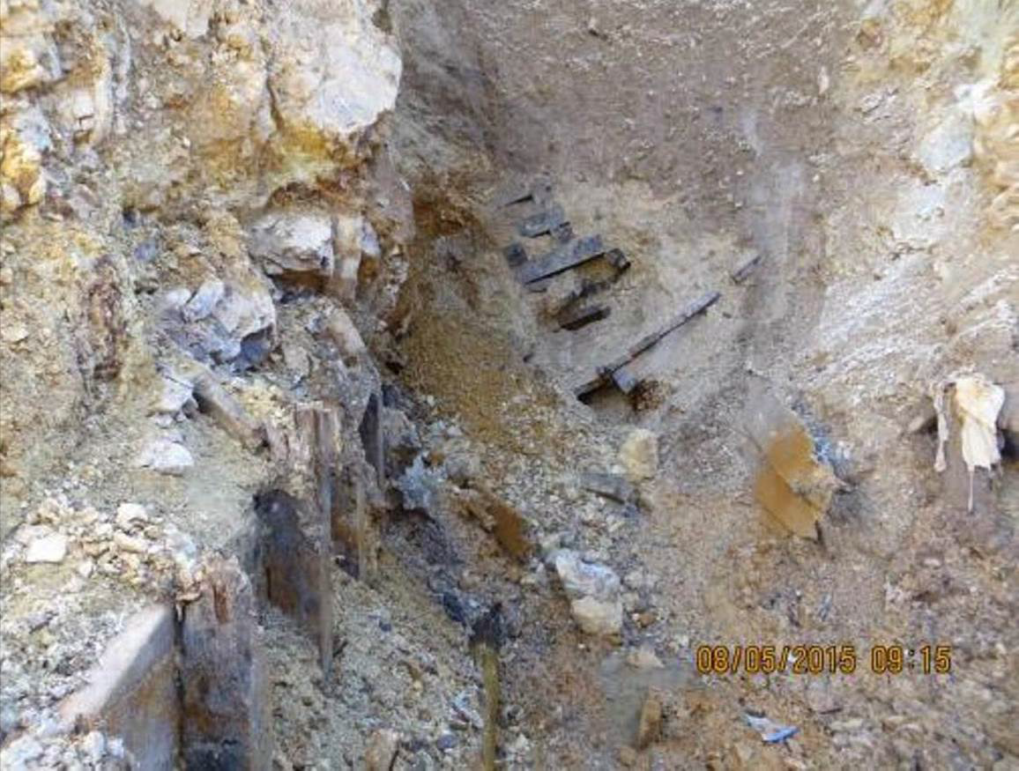
Figure 46.—Photograph taken at 9:15 a.m. August 5, 2015, showing the Gold King Mine Level 7 New Adit excavation uncovering mine timbers and lagging (photograph from EPA project files). Minor seepage is visible just to the left of the date stamp where a small puddle has formed. Note the soil in the upper end of the excavation above the timber lagging.

Slide 60
Rationale for proceeding…
The DRMS specialists stated that they believed the water inside the adit was below the crown (top) of the adit for the following reasons:
The location of the upper seepage was stable and similar to what was seen in the summer of 2014.
No seeps or wet spots were visible higher up in the adit excavation, suggesting dry conditions behind that elevation.
Seepage at the base of the blockage was stable at 69 gpm.
The decrease in seepage at the base compared to previous years could be explained by seasonal variations in drainage flow.
Only a small flow was coming out of the other (old) adit located about 100 feet away. These two adits were connected inside the mine about 970 feet back. If the mine were full, the old adit should be flowing more.
The mine was high on the mountain, 427 feet above the Red and Bonita Mine. It was unlikely that groundwater was high this far up on the mountain.

Slide 61
Implementation: Aug 5, 2015, cont’d
DRMS again discussed the plan to reopen the adit with the EPA OSC and were in agreement to proceed.
The two DRMS specialists left the site, and the contractor began excavating

Slide 62
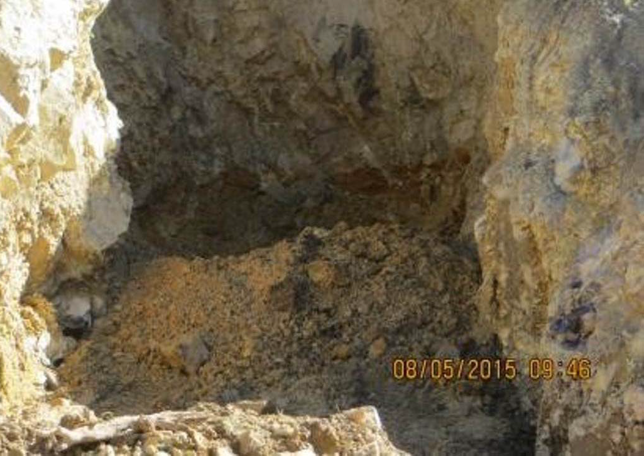
Figure 47.—Photograph taken at 9:46 a.m. August 5, 2015, showing that the loose soil from the upper end of the excavation had been removed exposing fractured and crumbly rock (photograph from EPA project files). The fill derived from the excavation had now covered the timbers, lagging, and seep visible in the previous photograph (figure 46). This indicates that the bottom of the excavation was about 10 feet above the level of the floor of the adit; this corroborates reports that they were digging high, trying to stay above the assumed water level in the adit.

Slide 63
We hit a “spring”…
As the excavator continued to dig on August 5, 2015, the operator reported hitting a “spring”
He stopped, they removed the excavator, and the EPA OSC went up to look at the conditions
Within moments, the “spring” began spurting upward 1.5 to 2 feet into the air
The EPA OSC reported that the water was initially clear and then turned red; in about 3 minutes it turned orange and the flow increased rapidly

Slide 64
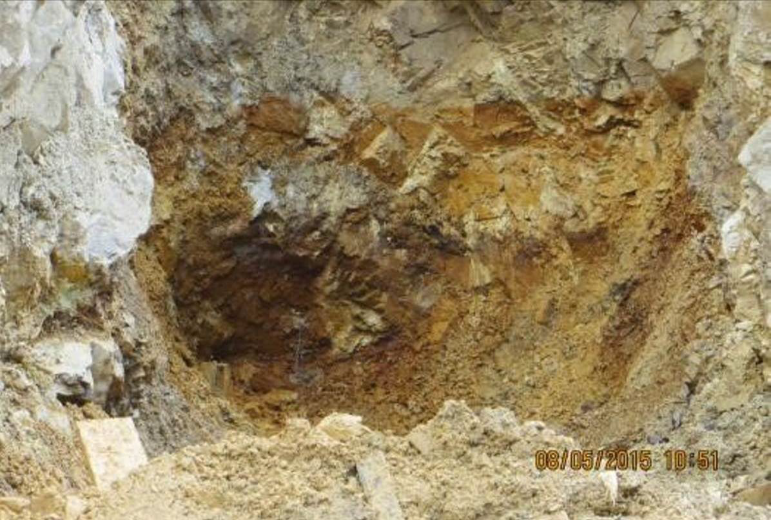
Figure 48.—Photograph taken at 10:51 a.m. on August 5, 2015, showing the initial spurt of clear water (photograph from EPA project files). The center of this photograph is shown enlarged in figure 49.

Slide 65
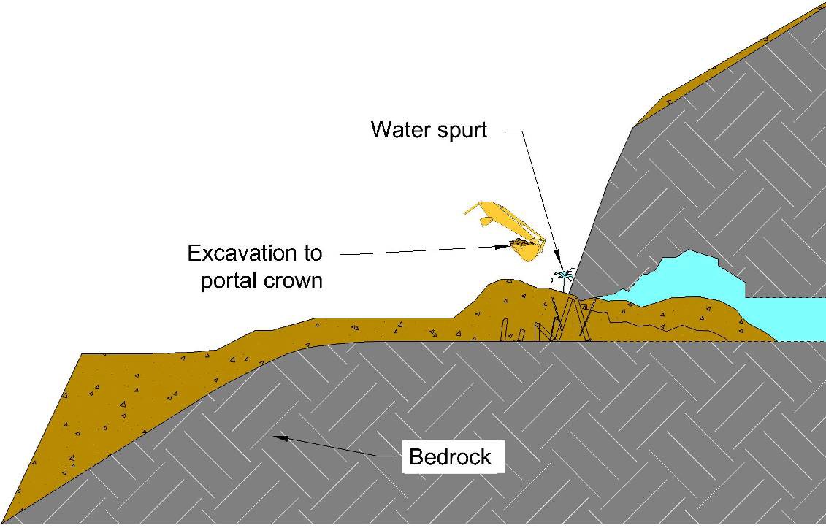
Figure 50.—Cross-section showing BOR’s interpretation of the conditions immediately before the blowout as the spurt of water appeared indicating the adit was full and under pressure (not to scale).

Slide 66
Figure 40.—Cross-section illustration showing the condition of the adit that was assumed by the EPA OSC and the abandoned mine experts from DRMS for use in planning to open the adit (not to scale). The “exaggeration point” means the right side of the drawing has an exaggerated vertical scale in order to show the 1% uphill slope of the adit. If drawn without exaggeration, the uphill slope of the adit would not be obvious on the drawing.

Slide 67
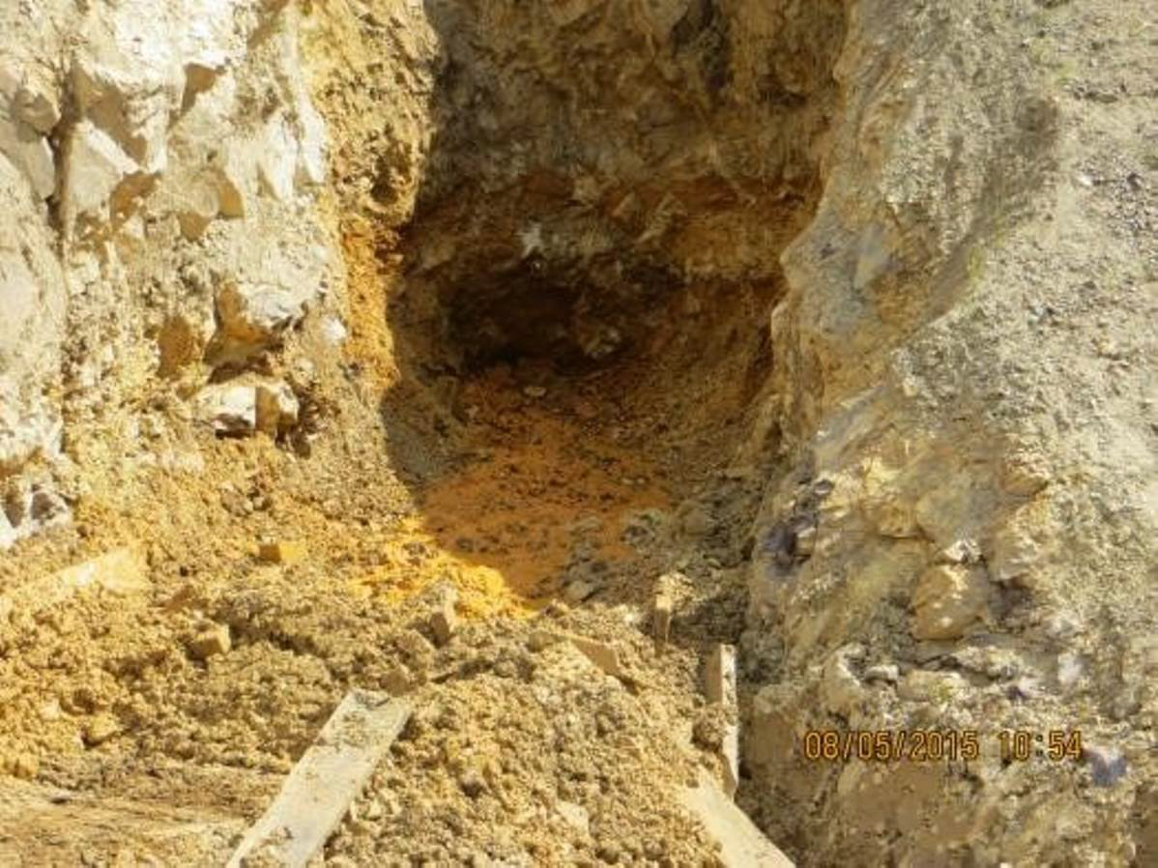
Figure 51.—Photograph of the uncontrolled flow taken at 10:54 a.m. on August 5, 2015. In 3 minutes, the flow progressed from a vertical spurt of water to the flow erosion evident in this photograph. The EPA OSC then made a decision to evacuate the portal opening to safeguard personnel onsite. A few moments later the flow erupted in an uncontrolled release (photograph from EPA project files).

Slide 68
DRMS and EPA realized the error!
It is important to note that, in figure 50, BOR’s interpretation of the water level inside the mine shows the adit full
This is unlike the lower water levels previously depicted based on DRMS and EPA assumptions from 2009 to the occurrence of the blowout.

Slide 69
The uncontrolled release
Figure 52.—Photograph showing the initial blowout from the adit. At this point, the flow is surging up over the backfill that was present in the portal area (still frame extracted from a video taken on August 5, 2015, at approximately 10:55 a.m.).

Slide 70
Figure 53.—Photograph showing the blowout at 10:56 a.m. on August 5, 2015 (photograph from EPA project files).

Slide 71
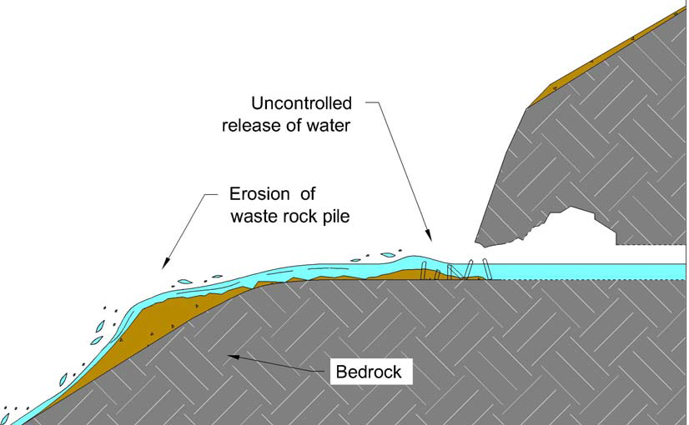
Figure 55.—Cross-section showing the blowout as it eroded the blockage and eroded fill from the waste-rock dump (not to scale).

Slide 72
Figure 56.—Photograph showing at left, the inundation of a vehicle parked near the base of the waste-rock dump, and on the right water overwhelming the access road and cascading down into the North Fork of Cement Creek (still frame extracted from a video taken on August 5, 2015, at approximately 10:57 a.m.).

Slide 73
Actions Taken After the Release to Repair and Stabilize the Site
EPA called down for the roads to be blocked where the stream crosses them, which was promptly accomplished.
They also had word passed on to people in Silverton…

Slide 74
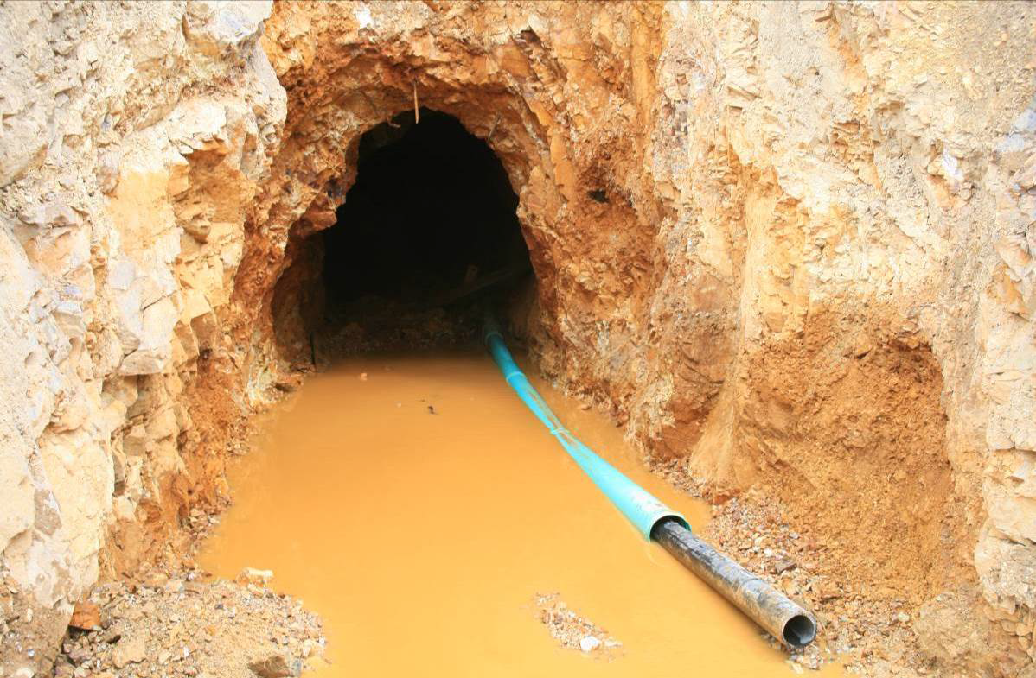
Figure 63.—Photograph showing the adit on August 16, 2015, with an 80-ft long (four 20-foot segments) turquoise-colored 24-inch outside-diameter drain pipe inserted into the adit opening. An 8-inch inside-diameter black HDPE pipe has been inserted into the 24-inch diameter pipe.

Slide 75
HOW COULD THIS HAVE HAPPENED?
CRITICAL THINKING CASE STUDY: Gold King Mine Incident
CE 4200: Professional Engineering Practice Issues
Spring 2022 Semester
William D. Lawson, PE, PhD

Slide 76
Engineering Analysis
A cursory engineering analysis of the incident was performed by the evaluation team to examine potential failure modes, extent of the mine pool as it relates to the water pressure at the plug and the volume of discharge as a consequence of plug failure, likely soil properties and the effect on flow through the backfill plug, and stability of the backfill plug.

Slide 77
Potential Failure Mode
FIVE possible failure modes explored
Determination:
Excavation Induced Failure – While attempting to open a blocked mine the seepage pathway is shortened and one of the previous failure modes (instability) is triggered.

Slide 78
Extent of the Mine Pool
The EPA project team assumed that the adit was not full to the top with water based on visual observations made on September 11, 2014, and again on August 4 and August 5, 2015.
The indirect evidence about the water level in the mine appeared persuasive
The prospect of drilling into the mine from above was far more challenging than at Red and Bonita.
Water from the adit was flowing through the lower portion of the backfill at a rate of 69 gpm giving the impression that there was a free flowing system and that water was not rising in the mine pool.

Slide 79
ERRORS IN JUDGMENT
Incorrect interpretation of extent of the mine pool
Incorrect interpretation of evidence for flow attenuation
Incorrect interpretation of potential for failure of the earth “plug”
Due consideration of the current state of practice in abandoned mine reclamation

Slide 80
What do we mean by critical thinking?
Critical thinking means making reasoned judgments that are logical and well-thought out. It is a way of thinking in which you don't simply accept all arguments and conclusions you are exposed to but rather have an attitude involving questioning such arguments and conclusions.
~ Tara DeLecce

Slide 81
What is the result of critical thinking?
A well-cultivated critical thinker:
Raises vital questions and problems, formulating them clearly and precisely
Gathers and assesses relevant information, using abstract ideas to interpret it effectively
Comes to well-reasoned conclusions and solutions, testing them against relevant criteria and standards
Thinks open-mindedly within alternative systems of thought, recognizing and assessing, as needs be, their assumptions, implications, and practical consequences
Communicates effectively with others in figuring out solutions to complex problems
~ The Foundation for Critical Thinking

Slide 82
CONCLUSIONS
CRITICAL THINKING CASE STUDY: Gold King Mine Incident
CE 4200: Professional Engineering Practice Issues
Spring 2022 Semester
William D. Lawson, PE, PhD

Slide 83
FINDINGS
The final events leading to the blowout and uncontrolled release of water occurred because of a combination of
An inadequately designed closure of the mine portal in 2009 and
A misinterpretation of the groundwater conditions when reopening the mine portal in 2014 and 2015.

Slide 84
FINDINGS, cont’d
EPA, in consultation with DRMS, concluded that the adit was partially full of water based excavations made into the downstream side of backfill placed at the portal.
Adit seepage was observed in the downstream excavations to be emerging at an elevation about 6 feet above the adit floor.
It was incorrectly concluded that the water level inside the mine was at a similar elevation, a few feet below the top of the adit roof.
This error resulted in development of a plan to open the mine in a manner that appeared to guard against blowout but instead led directly to the failure.

Slide 85
FINDINGS, cont’d
The collapsed material in the adit and the backfill added in 2009 were derived from the collapsed rock and soil that contained a significant amount of clay.
It was not a typical roof collapse comprised mostly of cohesionless, broken rock.
The clay content contributed to the significant attenuation (head loss) of flow in the collapsed debris and backfill as the mine water flowed through it.
In addition, deposition of iron-oxyhydroxide sediment inside the mine likely contributed to additional reductions in the seepage flow

Slide 86
FINDINGS, cont’d
After the EPA project team concluded that the adit was not full to the top with water, they implemented a plan to open the mine in a manner similar to the one used successfully to reopen the adit at the nearby Red and Bonita Mine in 2011.

Slide 87
FINDINGS, cont’d
A critical difference between the Gold King plan and that used at the Red and Bonita Mine in 2011 was the use of a drill rig to bore into the mine from above to directly determine the level of the mine pool prior to excavating backfill at the portal.
Although this was apparently considered at Gold King, it was not done.
Had it been done, the plan to open the mine would have been revised, and the blowout would not have occurred.

Slide 88
FINDINGS, cont’d
The incident at Gold King Mine is somewhat emblematic of the current state of practice in abandoned mine remediation
The current state of practice... focuses attention on the environmental issues
Abandoned mine guidelines and manuals provide detailed guidance on environmental sampling, waste characterization, and water treatment
There is little appreciation for the engineering complexity of some abandoned mine projects that often require, but do not receive, a significant level of expertise

Slide 89
RECOMMENDATIONS
CRITICAL THINKING CASE STUDY: Gold King Mine Incident
CE 4200: Professional Engineering Practice Issues
Spring 2022 Semester
William D. Lawson, PE, PhD

Slide 90
Recommendations
Because of the complexity of reopening a flooded abandoned mine, a potential failure modes analysis should be incorporated into project planning.
Before opening an abandoned mine adit, review mine maps, production records, dump size, and local history about the mine to evaluate the potential volume of mine workings. If the volume is large, consider what would happen if there were an accidental release and what could be done to protect against it. A downstream-consequences analysis should be a part of every complex mine remediation.
Water conditions within the mine should be directly measured prior to opening a blocked mine. Indirect evidence is insufficient if the potential for a blowout exists.
Where significant consequences of failure are possible, independent expertise should be obtained to review project plans and designs prior to implementation.

Slide 91
WHAT’S NEXT
CRITICAL THINKING CASE STUDY: Gold King Mine Incident
CE 4200: Professional Engineering Practice Issues
Spring 2022 Semester
William D. Lawson, PE, PhD

Slide 92
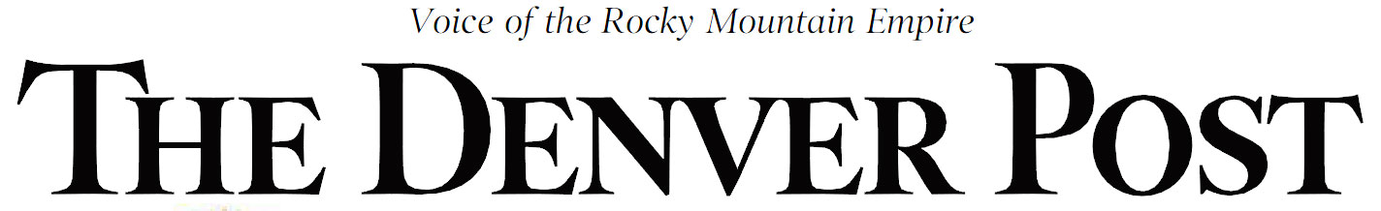
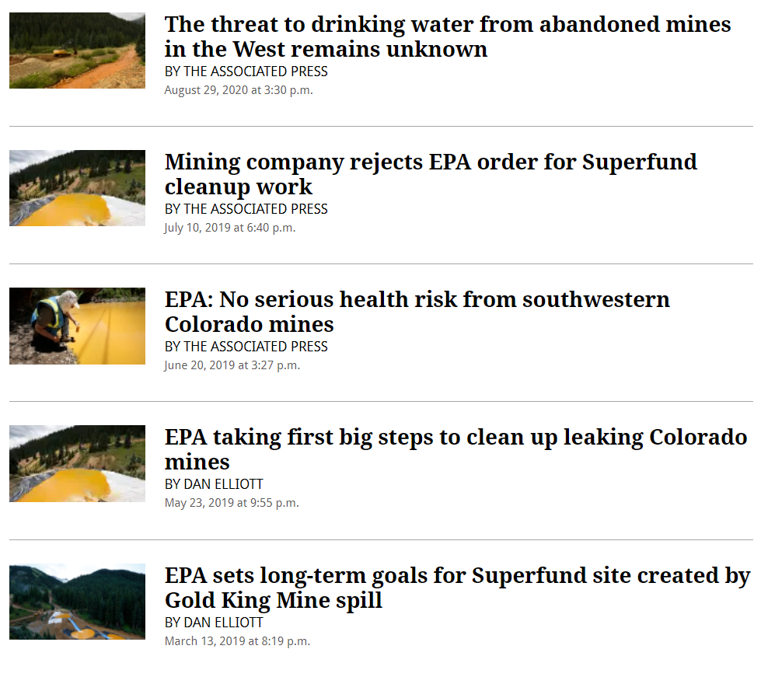


Slide 93


